Slide 1
Module 3
Ethernet Part II
By Dr. Percy DIAS
© 2016, Cisco Systems, Inc. All rights reserved.

Slide 2
Collisions and Collision Domain
Collision is a situation that can occur when 2 bits propagate at the same time on the same network.
Collision domains are the connected physical network segments where collisions can occur.

Slide 3
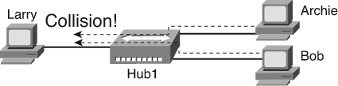
Collisions
Hubs operate at Layer 1, simply repeating all received signals out all other ports

Slide 4
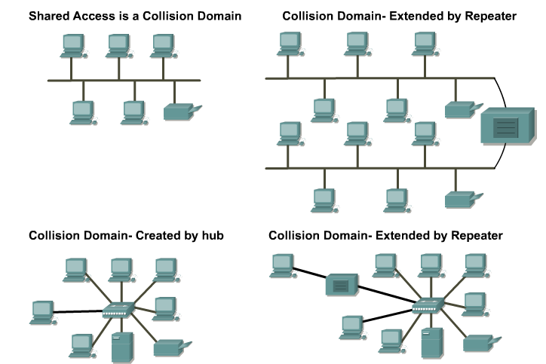
Collisions and Collision Domain

Slide 5
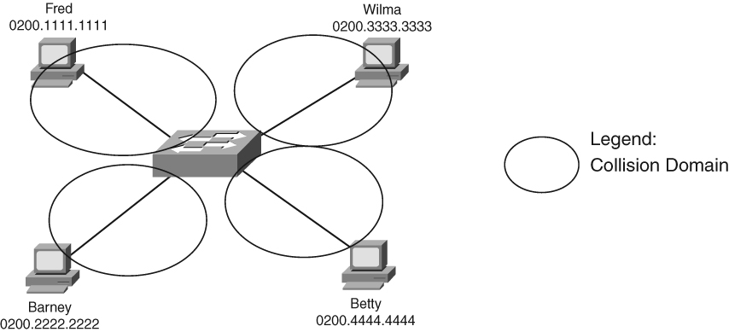
Collision Domains with a Switch

Slide 6
Collision Domains and Full Duplex
Each port of a switch creates its own collision domain
A frame in one collision domain does not cause collisions in another collision domain
The switch’s buffering process prevents the collisions
When full duplex is enabled:
  NICs/Interfaces can send and receive at same time
  CSMA/CD is no longer needed as collisions can’t occur
  Full duplex cannot be used if a hub is plugged into the port

Slide 7
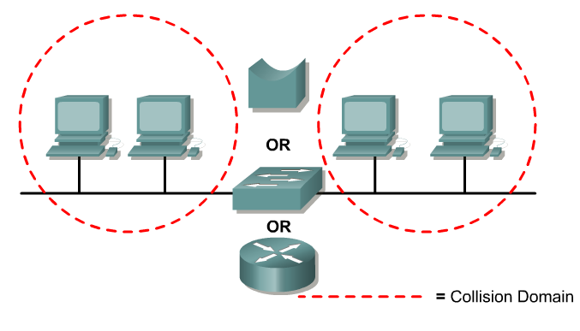
Collision Domain Segmentation
Breaking up or increasing the number of collision domains with layer 2 and 3 devices is known as segmentation

Slide 8
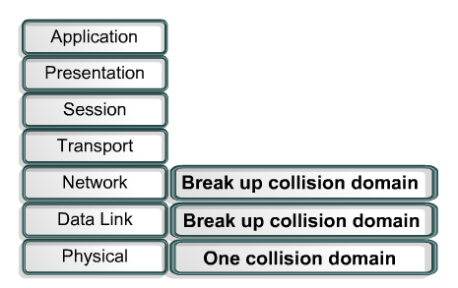
Collision Domain Segmentation

Slide 9
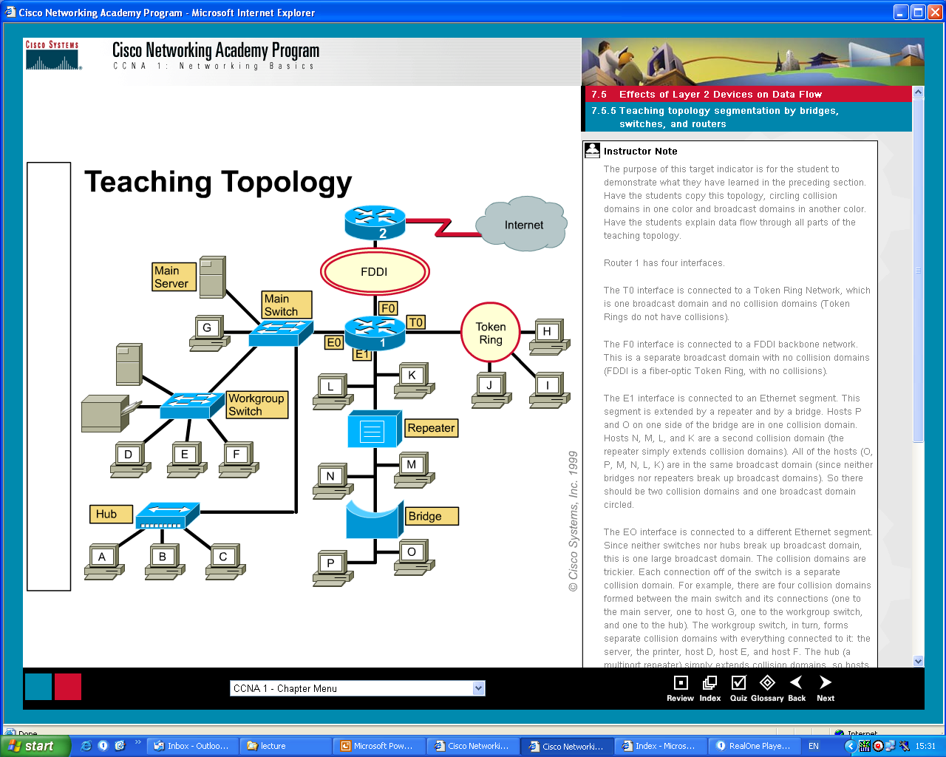
Collision Domain Segmentation

Slide 10
Layer 2 Broadcasts
When a node needs to communicate with all hosts on the network, it sends a broadcast frame with a destination MAC address 0xFFFFFFFFFFFF.
Layer 2 devices must flood all broadcast.
The accumulation of broadcast traffic from each device in the network is referred to as broadcast radiation.

Slide 11
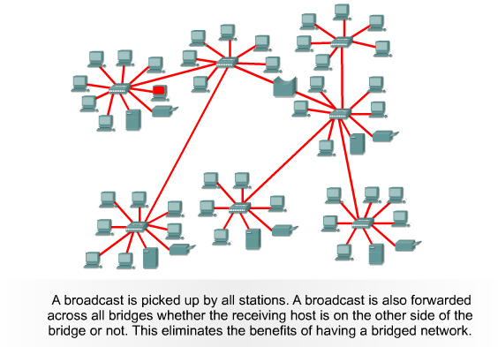
Broadcasts in a Bridged Environment

Slide 12
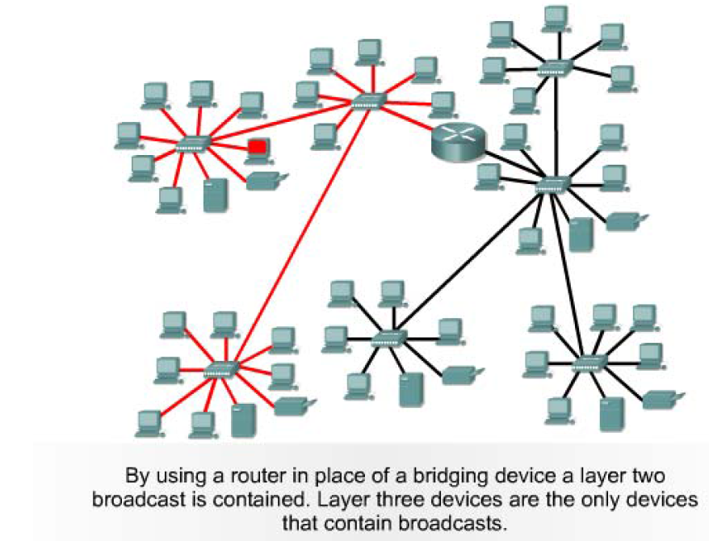
Broadcast Domain Segmentation

Slide 13
Broadcast Domains
A broadcast domain is a grouping of collision domains that are connected by Layer 2 devices.
Broadcasts are forwarded by Layer 2 devices and if excessive, can reduce the efficiency of the entire LAN.
Broadcasts have to be controlled at Layer 3, as Layer 2 and Layer 1 devices have no way of controlling them.

Slide 14
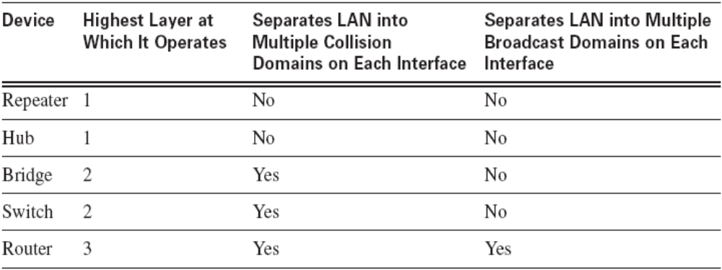
Collision Domains and Broadcast Domains

Slide 15
Cisco Networking Academy
CCNA Routing and Switching (CCNA5)
Routing and Switching Essentials
Slide No. | Chapter No.
2 – 5 | 1.2.2.1
6 – 9 | 1.2.2.3
11 - 13 | 1.2.2.2
20 - 22 | 3.3.1

